Slide 1
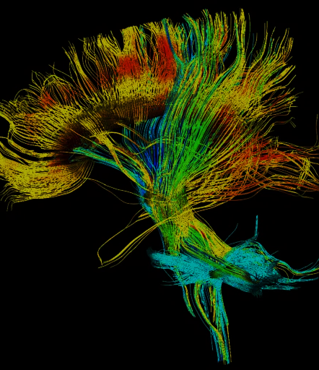





FUNCTIONAL MRI AND TRACTOGRAPHY IN BRAIN TUMORS: HANDS-ON-WORK
Europa Convention Center, Vitoria- Gasteiz (Spain) 13-14 Noviembre 2025
Course integrating theory and hands-on practice. This immersive course is structured into three core modules, emphasizing a balanced approach between foundational knowledge and applied learning:
1. Task-Based fMRI
2. Resting-State fMRI
3. Tractography
Each module spans 4 hours, divided into two key components:
2 hours of expert-led lectures: Delivered by renowned international and national specialists in neuroimaging.
2 hours of hands-on sessions: Practical training using real cases and software tools.
The course will utilize industry-leading tools, such as Syngovia (Siemens) and NNL (Nordic Neuro Lab), to provide participants with cutting-edge technical skills in data acquisition, processing, and analysis.

Slide 2
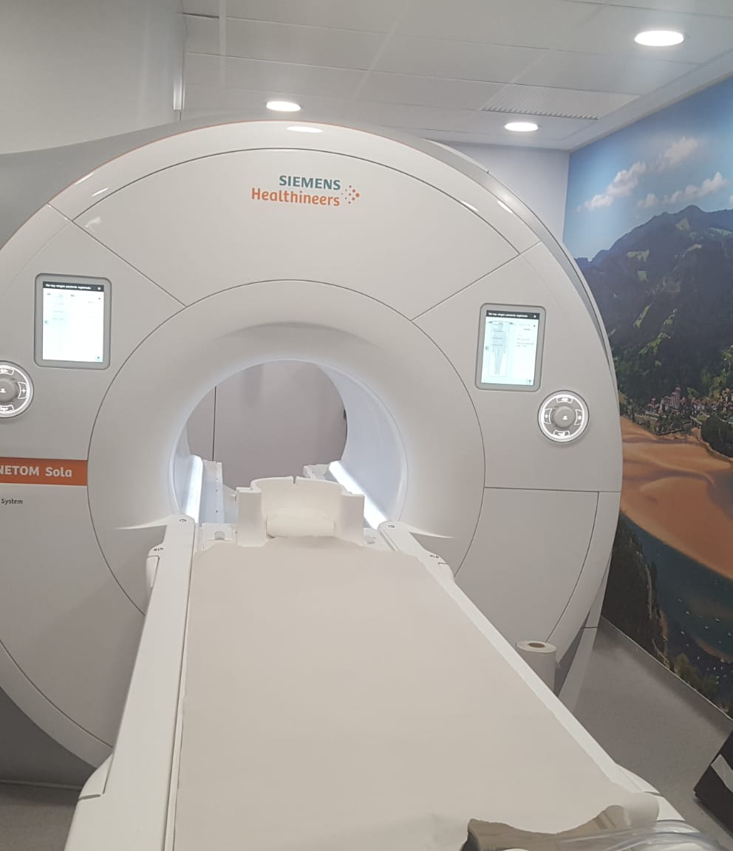
AGENDA
Location: Europa Convention Center, Vitoria- Gasteiz (Spain)
THURSDAY 13th NOVEMBER
1st MODULE: TASK-BASED FMRI
8:00-8:30. Register and accreditations
8:30-8:45. Workshop presentation
8:45-9:30. fMRI physics, technical requirements and image acquisition optimization. Paradigms: Language, motor and others (Dr Liu)
9:30-10:00. Primary and secondary language areas (Dr Kumar)
10:00-10:30. Clinical applications: What the neurosurgeon needs to know. (Dr. Cabrera)
10:30-10:50. Coffee break
10:50-13:00. Task-based fMRI workshop
13:00-14:00. Lunch break
2nd MODULE: RESTING STATE FMRI
14:00-14:30. Resting state: How do we obtain useful information? (Dr Liu)
14:30-15:00 Resting state: clinical applications in adults (Dr Kumar)
15:00-15:20. Aplicaciones de resting state en pediatría (Dra Saralegui)
15:20-15:45. Coffee break
15:45-18:00 Resting state workshop
SOCIAL EVENT (Cathedral guided visit and dinner)
FRIDAY 14th NOVEMBER
3rd MODULE: TRACTOGRAPHY
9-9,30: Physics and technical requirements (Dr. Liu)
9,30-10: Anatomy of main human white matter tracts. Dual stream language model (Dr. Kumar)
10-10,30: Aplicaciones clínicas de la tractografía. Lo que el cirujano necesita saber. (Dra Jimenez )
10,30-11: Virtual reality and augmented reality for preoperative planning (Dr Kumar)
11-11,30: Coffee break
11,30-13,45: Tractography workshop
13,45-14: Closing
CONFIRMED SPEAKERS
Dr Ho-Ling Anthony Liu, Professor and Chairman of the Department of Physical Imaging, MD Anderson, Houston,
Dr Vinodh A. Kumar, Vice-President of the American Society of Functional MRI, Neuroradiology, MD Anderson, Houston
Dr Ibone Saralegui, Osatek, Galdakao, Spain
Dr. Alberto Cabrera, HT Médica
Dr Mar Jiménez, Hospital Universitario Quirón salud, Madrid
Regular price: 450 €
Price for SENR members: 375 €
link to register:
Registration
More info or questions: Jornadas@osatek.eus

